Slide 1

Global Social Economy Forum
Activities for Combating Desertification and Achieving Local Sustainability in Mongolia
Green Asia Network / Ko, Jae Kwang

Slide 2
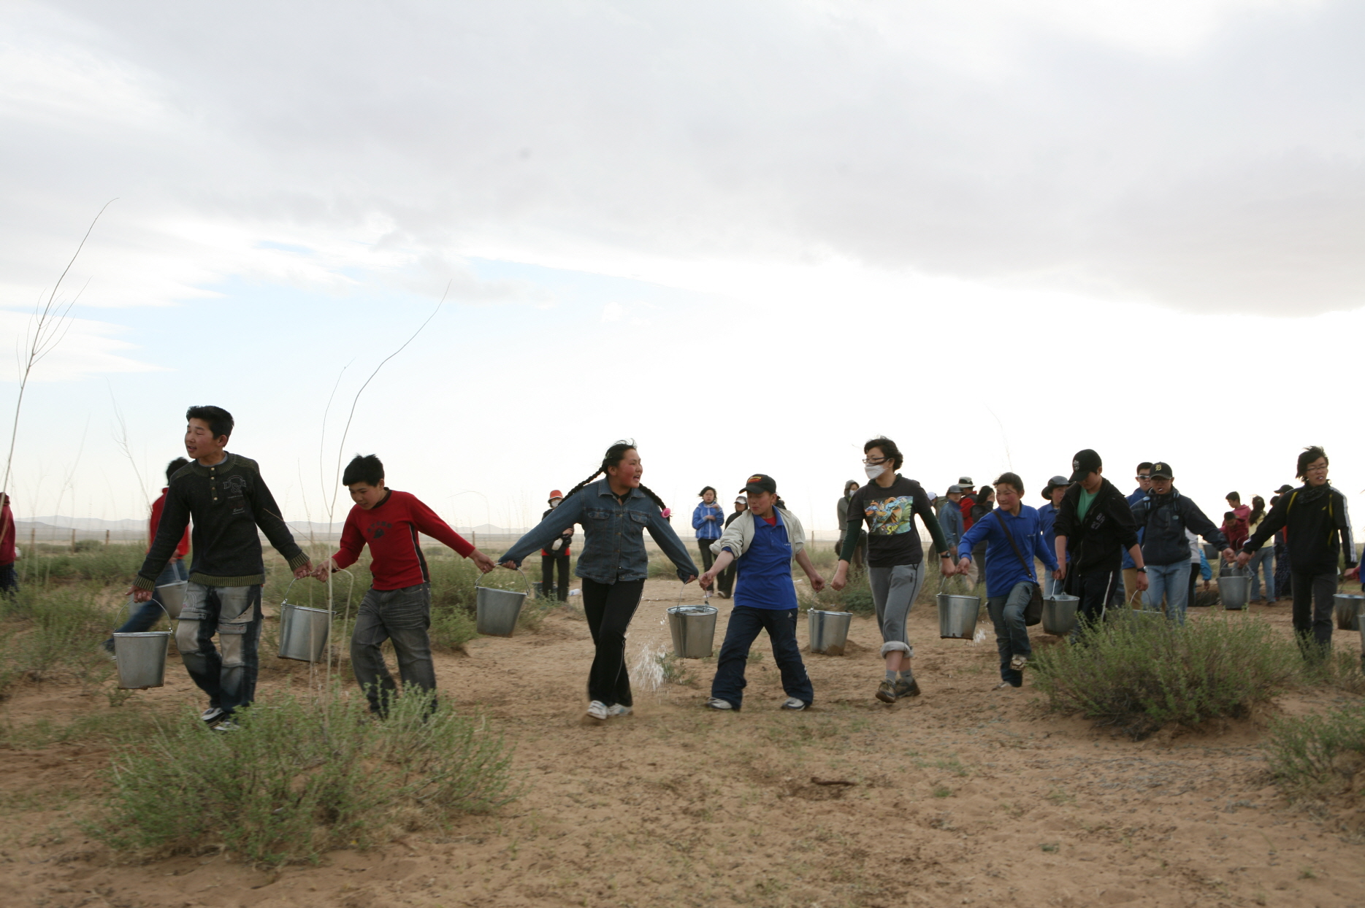

Green Asia Network
Established in 1998, registered on Korean Ministry of Foreign Affairs and Trade
Focusing on development of alternative model for combating climate change & desertification
Being accredited to GEF, UNFCCC, UNCCD / special consultation status of UNECOSOC
Has planted 500,000trees in about 500ha in Mongolia(-2014)
Currently, implementing the projects on combating desertification & developing sustainable regional development of 5 sites in Mongolia

Slide 3


Slide 4
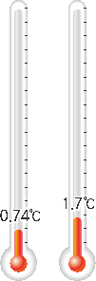
The Average Temperature of the Earth
  During the past 100 years,
  Global annual average temperature has
  been increased by Green House Gas Emission
  0.74℃ Increase
  (IPCC,2007)

Slide 5
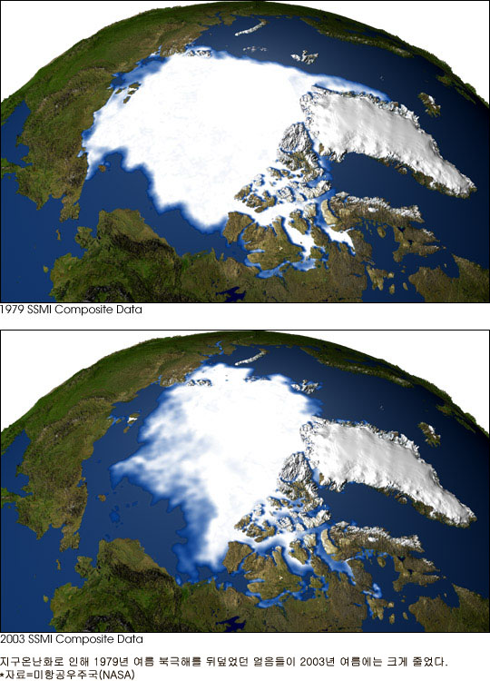
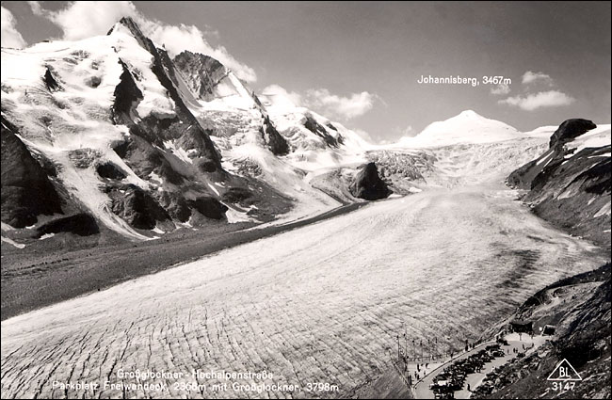
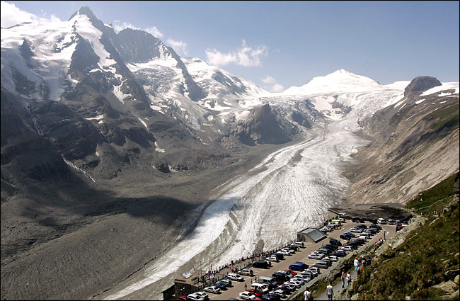
Global Environmental Crisis
Disappearance of glaciers
사라지는 빙하 (북극)
Notes:
북극의 모습인데요, 20년 사이의 변화입니다. 아메리카 (미국) 대륙 넓이 만큼의 빙하가 사라졌다고 합니다.

Slide 6
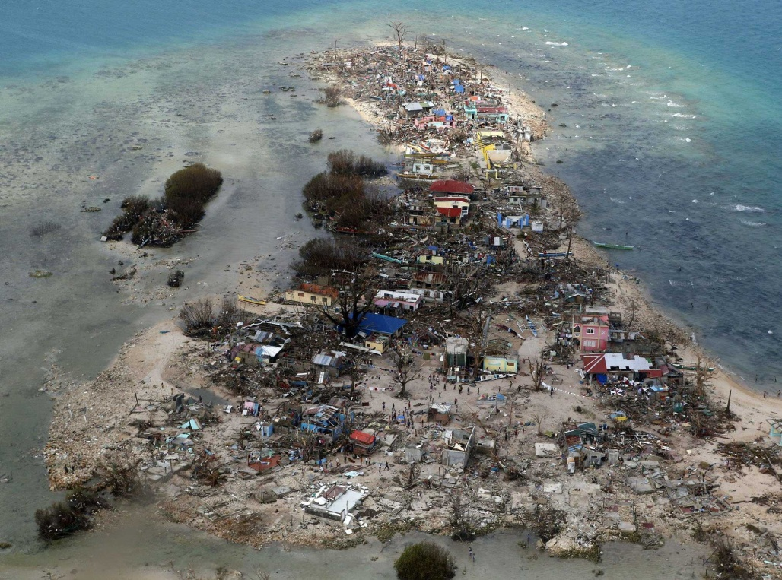
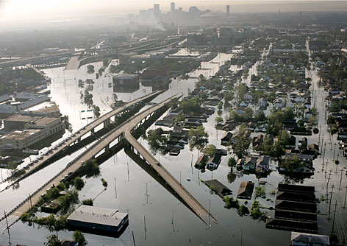
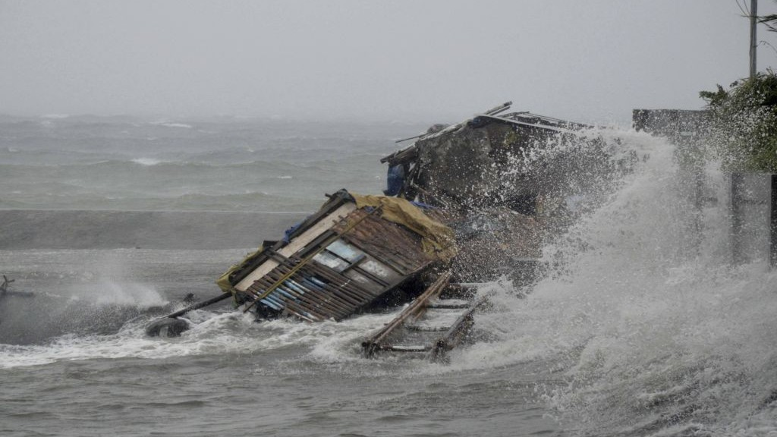
Global Environmental Crisis
Severe tropical cyclones and floods (강력한 태풍과 홍수)
Typhoon “Haiyan” in the Philippines(2013)
(2013년, 필리핀 하이옌 태풍)
Hurricane Katrina in the U.S.(2005)
(2005년, 허리케인 카트리나)
The cause: warm sea surface temperature
(원인: 해온 상승)
Notes:
강력한 슈퍼태풍과 홍수입니다. 작년 필리핀 태풍 기억하시죠? 2005년 선진국 미국에서도 허리케인 카트리나로 피해를 입었습니다. 원인은 바다의 온도가 높아졌기 때문입니다. 0.5도 증가로 인해 태풍의 강도와 발생 빈도가 2배로 늘었습니다.
초속 115미터
멕시코만 해온 증가로 .5도 효과: 태풍 강도 2배, 발생빈도 2배
Typhoon Haiyan in the Philippines(2013) Warm sea surface temperatures are known to be a cause of tropical cyclogenesis over the Earth's oceans.

Slide 7
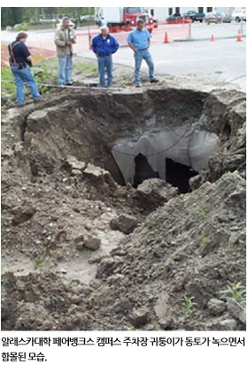
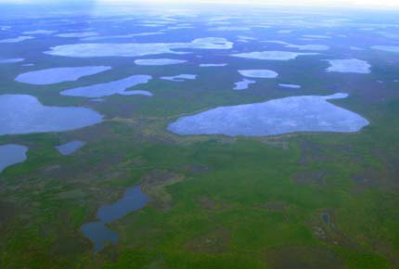
Global Environmental Crisis
Melting Permafrost (영구동토층 융해)
Release of CO2 and methane gas in the permafrost of Siberia and Alaska
(시베리아와 알래스카 지역의 영구동토층 융해로 인한 이산화탄소 및 메탄가스 방출)
CO2(500 billion tons) and Methane gas(50 billion tons) are buried
Alaska, destructed Parking Lot
Melted Lake Siberia

Slide 8
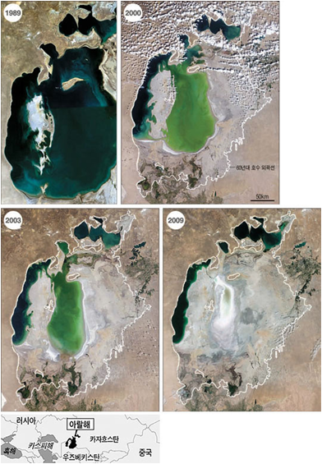
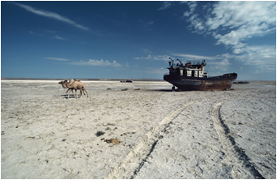
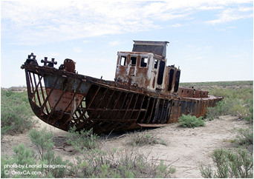
Global Environmental Crisis
Shrinking of the Aral Sea
사라지는 아랄해

Slide 9
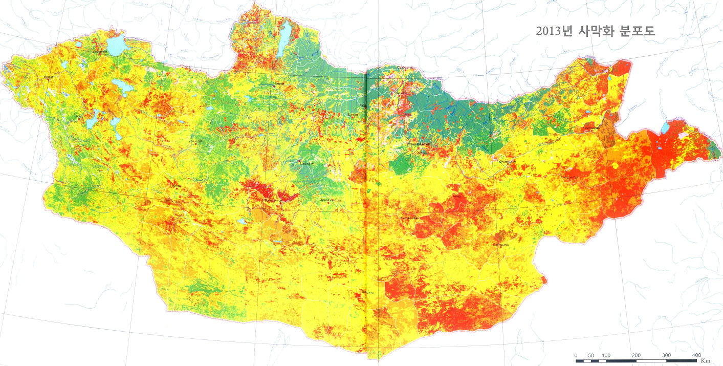
The Impact of Climate Change in Mongolia
78% of Mongolia is suffering from desertification : Mongolian government (2010)
(Ministry of Environment and Green Development of Mongolia, official document, 2010)
Increase by 2.1°C(Annual average temperature of Mongolia in the past
60 years)
Notes:
아시아 기후변화의 피해는 특히 사막화가 있는데, 그 중 가장 큰 피해를 입고 있는 국가는 바로 ‘몽골’입니다. 몽골은 변변한 공장 하나 없는, 온실가스를 유발하지 않는 국가이지만 ‘사막화’의 형태로 기후변화 최대 피해국입니다.

Slide 10
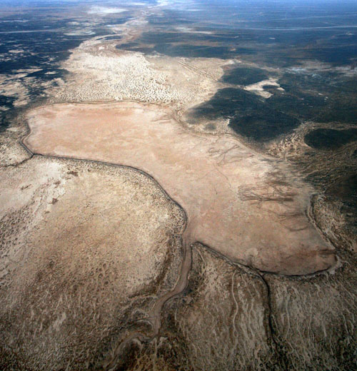
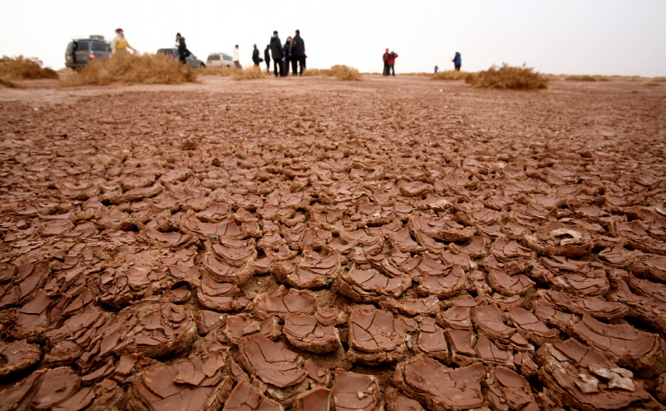
The impact of Climate Change in Mongolia
Disappearance of
- 887 rivers and streams (887개의 강)
- 2,069 springs (2,069개의 시내)
- 1,166 lakes and ponds (1,166개의 호수)
Notes:
아시아 기후변화의 피해는 특히 사막화가 있는데, 그 중 가장 큰 피해를 입고 있는 국가는 바로 ‘몽골’입니다. 몽골은 변변한 공장 하나 없는, 온실가스를 유발하지 않는 국가이지만 ‘사막화’의 형태로 기후변화 최대 피해국입니다.

Slide 11
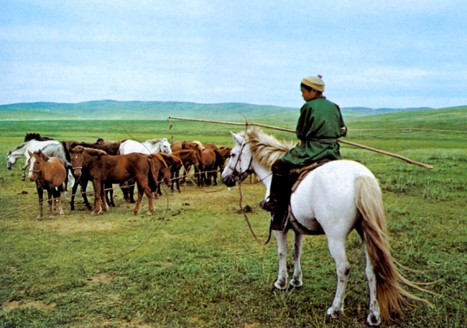
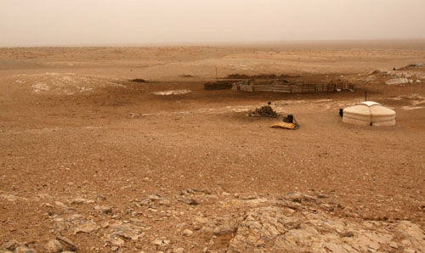
The impact of Climate Change in Mongolia
Harsh life for the Nomads
(기후변화로 인해 유목 생활 불가능해짐)

Slide 12
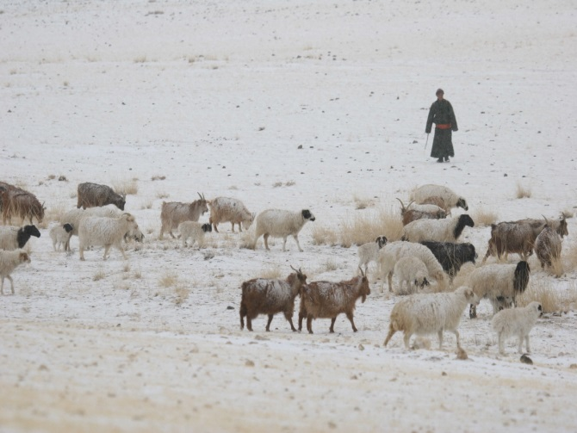
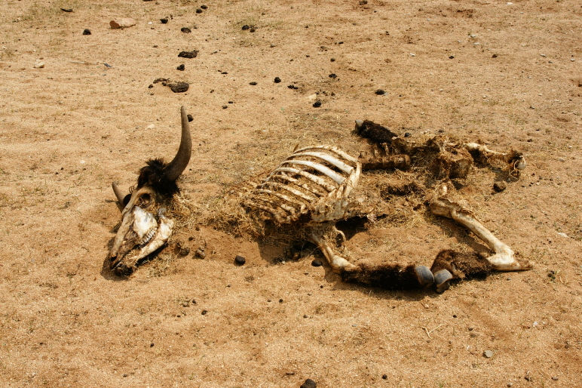
The impact of Climate Change in Mongolia
From 1999 to 2002, severe winters (called Dzud in Mongolian) killed 11 million livestock, leaving 12,000 households environmental refugees
(‘조드’라 불리는 자연재해는 천만 마리의 가축을 죽이고
1.2천 가정이 환경 난민으로 전락시킴)

Slide 13
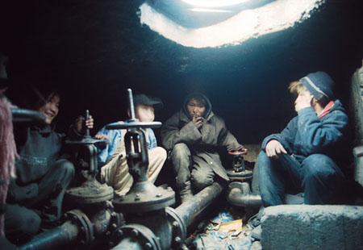
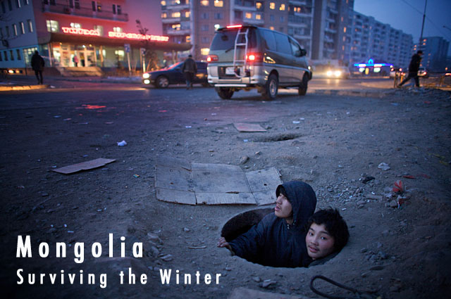
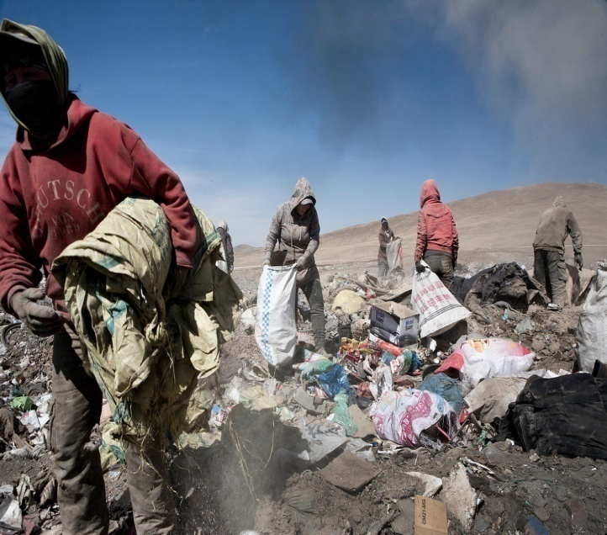
Desertification and Environmental Refugees
The Hunger of North Korea
“Herders who lost their livestock has been driven into the city under population saturation. However it`s an futile attempt.
Mongolia dose not absolutely prepare for natural disaster.”
Nomadic pastoralists left their home for job to cities fall into the poverty
(가축을 잃은 유목민은 도시로 일자리를 찾으러 와 도시 빈민으로 전락)
Climate change(desertification) and poverty are like two sides of same coin
(기후변화(사막화)와 빈곤은 동전의 양면)

Slide 14
GAN’s activities target the environmental threat by addressing problems related to land degradation and eco refugees
그래서 푸른아시아는 사막화와 환경난민 등 환경위기를
해결하기 위한 활동들을 하게 되었습니다.

Slide 15
Sustainable Regional Development Model
Achieving Local Sustainablity
지속가능한 지역 개발 모델
01
Environment Rehabilitation(환경복원)
Environment 환경
Abatement of Desertification (사막화 저감)
Afforestation (조림 및 산림 증대)
Water Retaining (수자원 증대, 습도 증가)
Responding to Climate Change (기후변화 대응)
Social 사회
02
Empowerment (주민역량 개발)
Economy
경제
Environment and Agricaultural Education (환경 및 농임업 교육)
Enhancing Human Rights and Welfare (인권과 복지 증진)
Local Participation (주민 참여)
Self Reliance (자립 능력 향상)
03
Job Creation (일자리)
Training and Specialization (직업 교육, 전문성 강화)
Establishing a Cooperative (협동조합 설립)

Slide 16
Local Sustainability
The Region
The Local

Slide 17
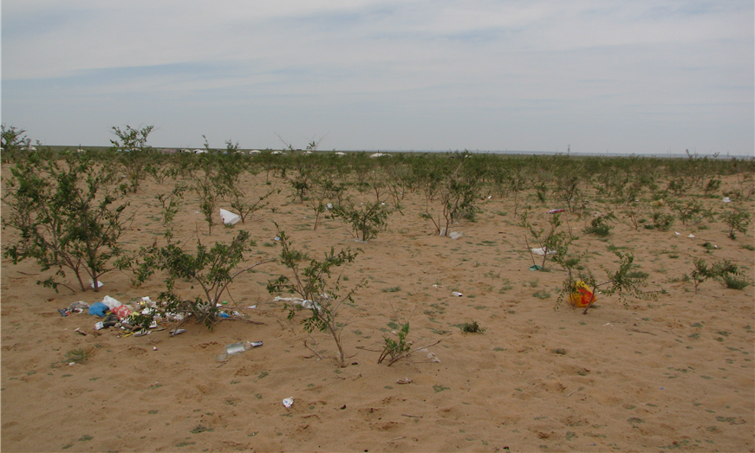
Barren Forestry Site in Mongolia

Slide 18
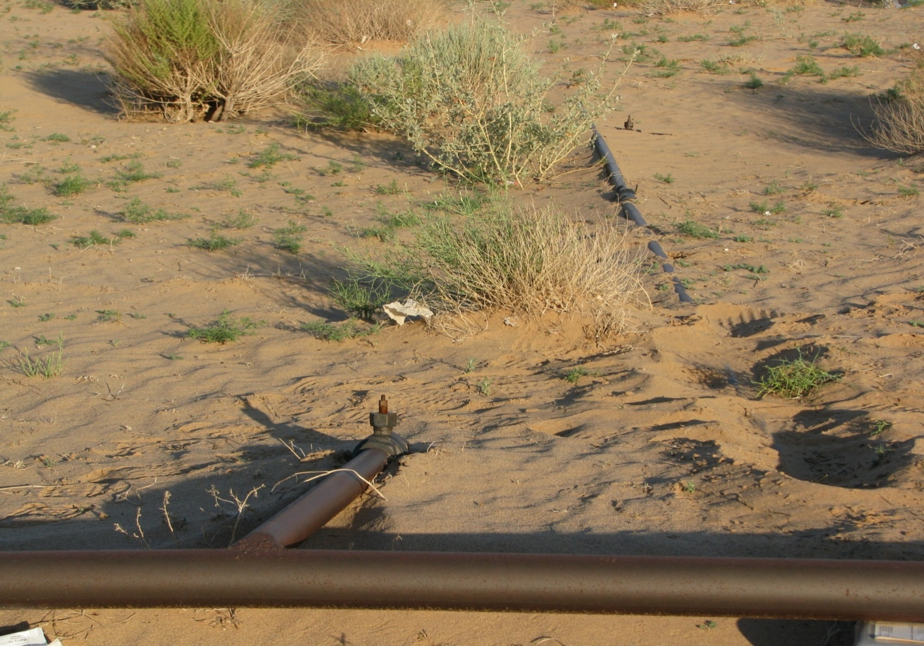
Barren Forestry Site in Mongolia

Slide 19
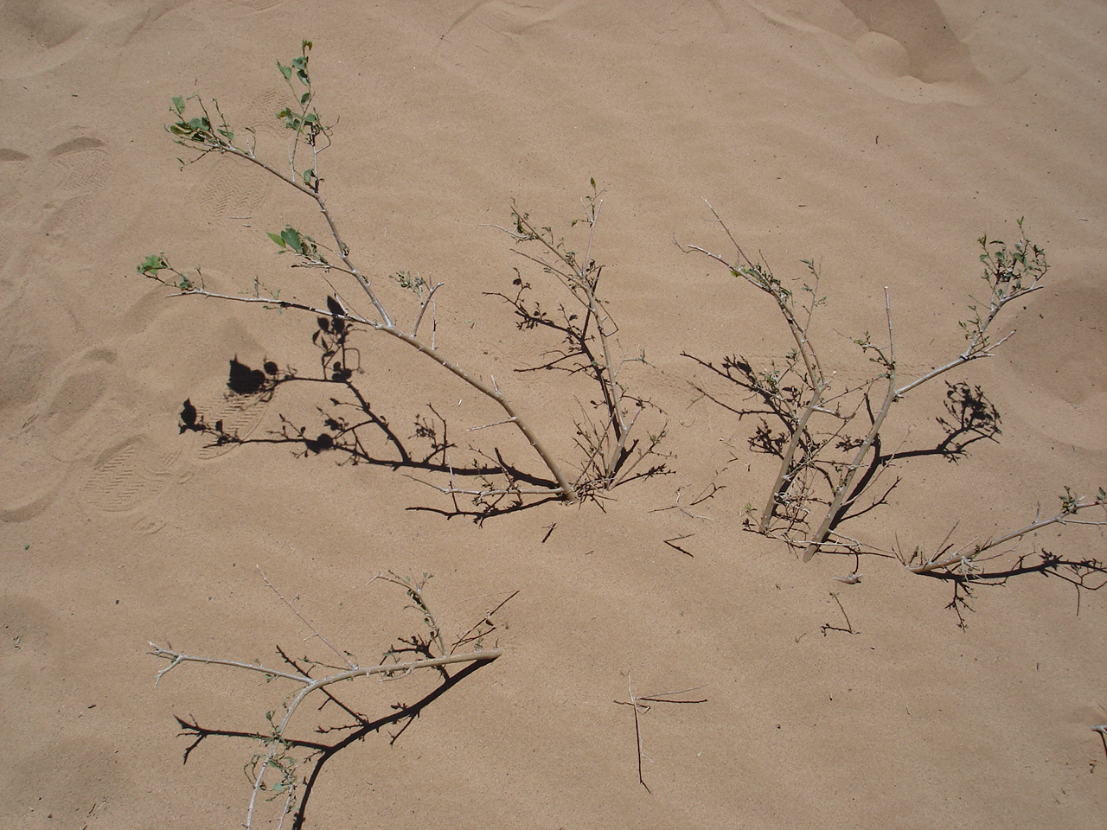
Barren Forestry Site in Mongolia

Slide 20
Local Sustainability
The Region
The Local

Slide 21
Local Sustainability of The Local
Participation
Empowerment
Ownership

Slide 22
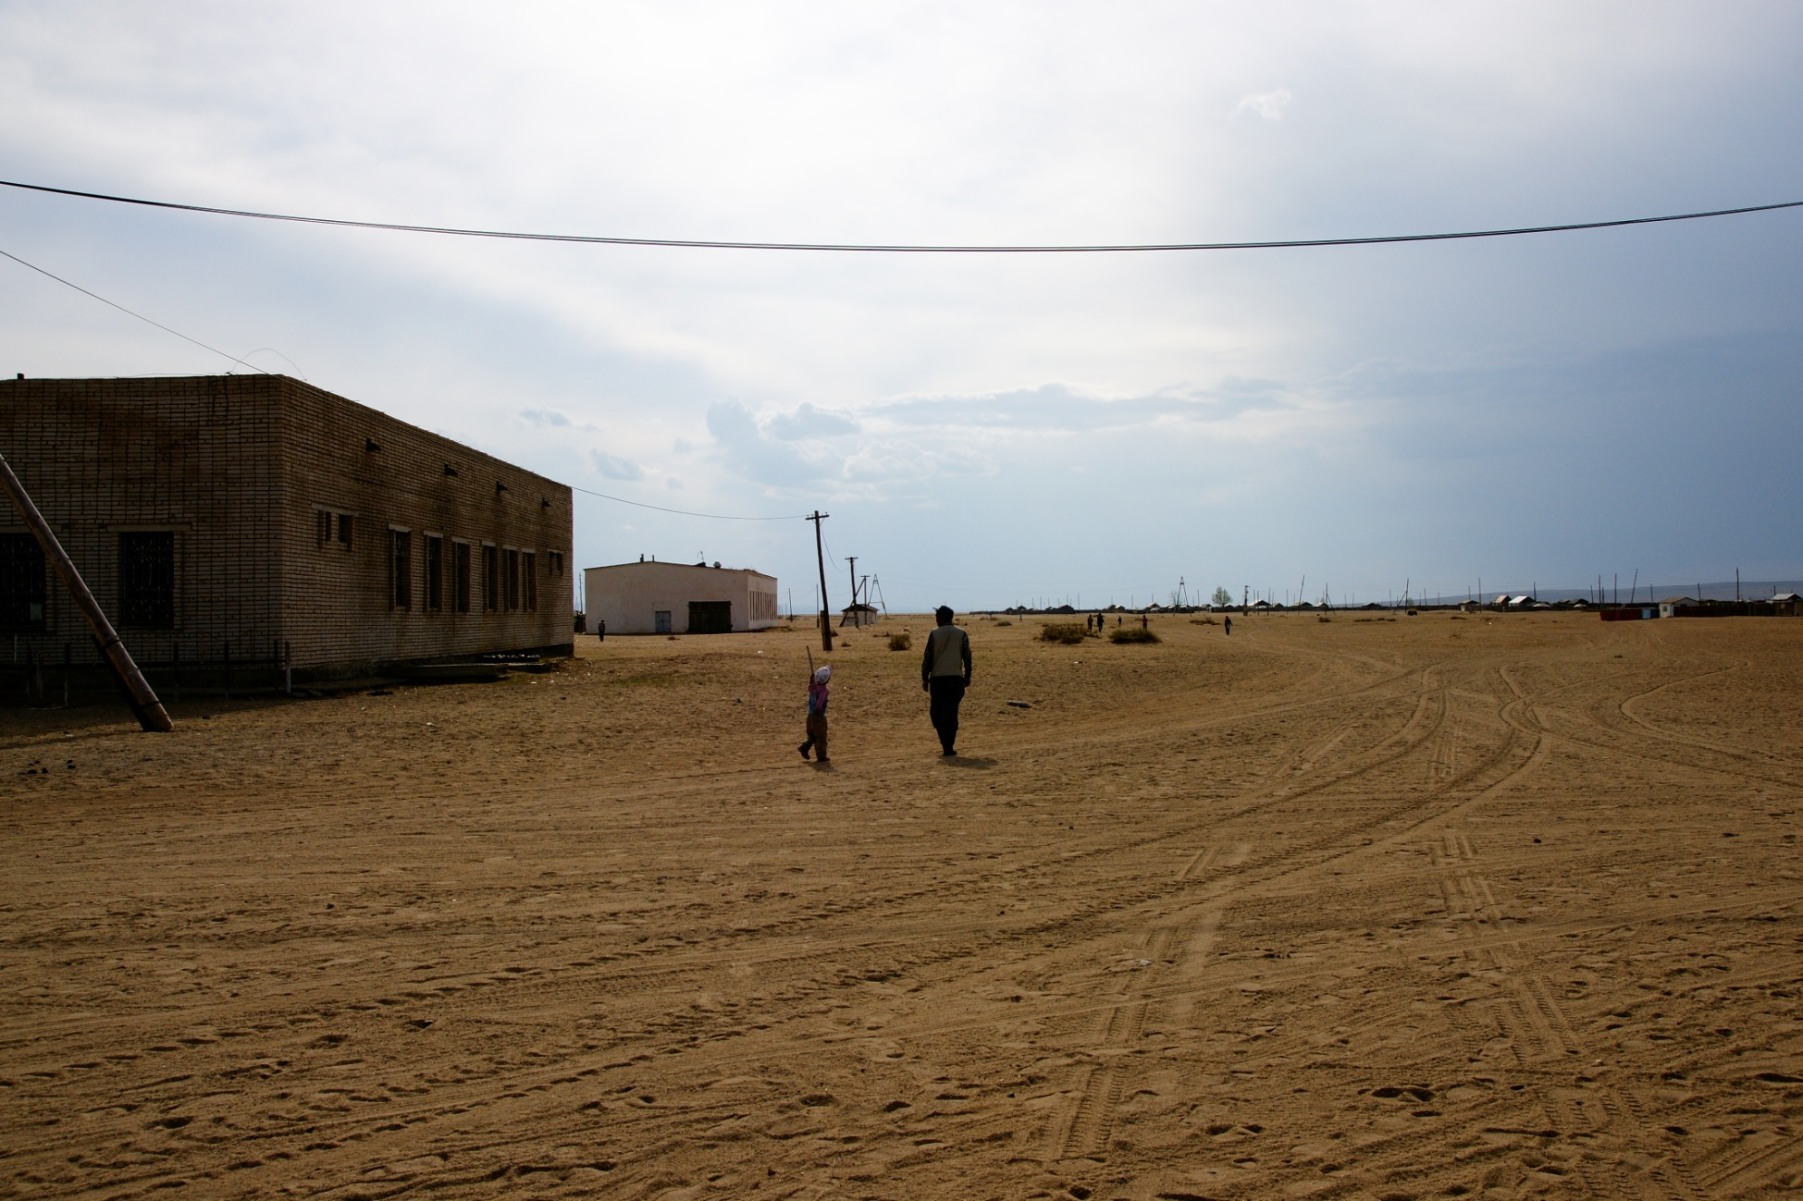

Bayannuur Soum, Mongolia
: 96,000ha in extent, 190km west from Ulaanbaatar
: ‘Bayan’ means ‘plentiful’, and ‘nuur’ means ‘lake’ in Mongolian
: Once was known for fruit tree farming and hay cultivation
using its abundant water resources
: Due to the rapid desertification in recent decades,
now there are only 6 lakes out of previous 15 lakes

Slide 23
Local Sustainability
The Region
The Local
Afforestation to
Combat Desertification
Participation
Empowerment
Ownership

Slide 24
Local Sustainability of The Local
Participation
Empowerment
Ownership
• Local Economic
Self-Sufficiency

Slide 25
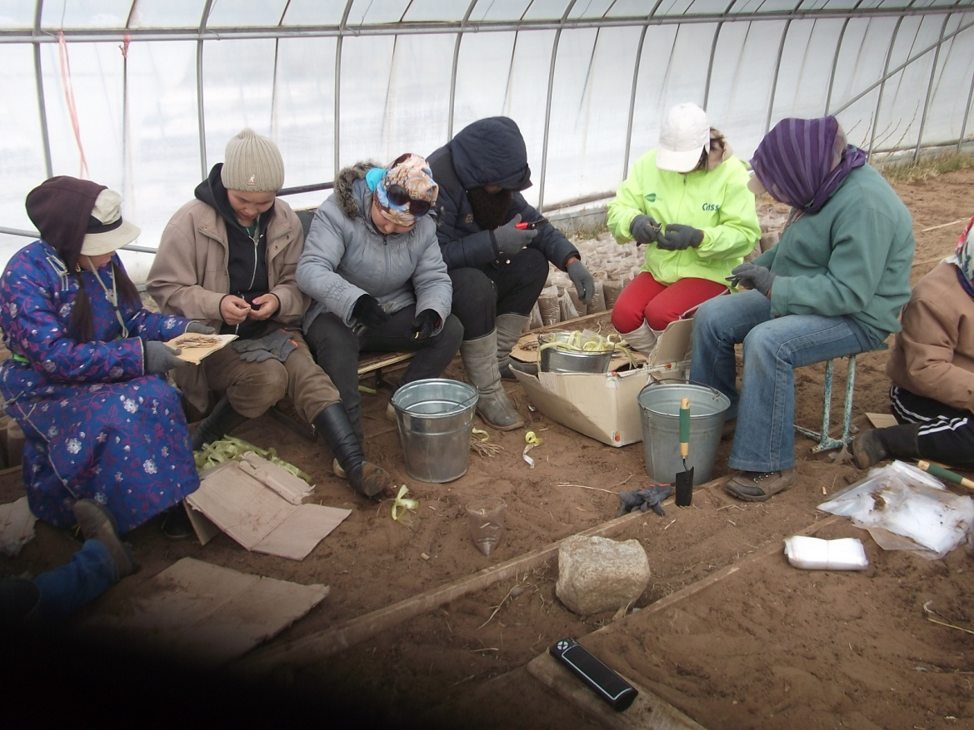
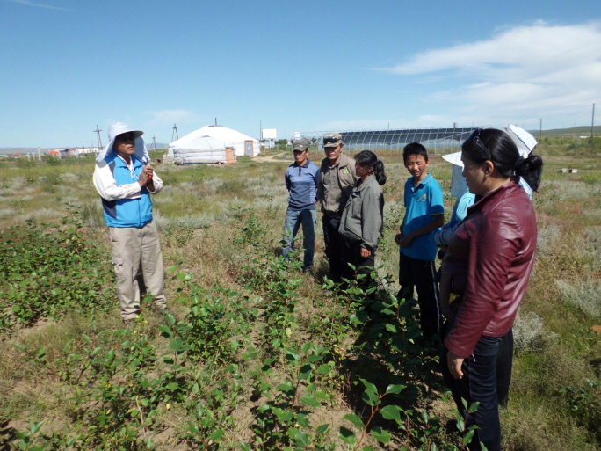
<Job Creation>
• Job Creation for 45~55 Households
(Out of 410 households/1,791 people in BY)
- Planting/Managing Trees and Guarding
Local Economic Self-Sufficiency
Participation

Slide 26
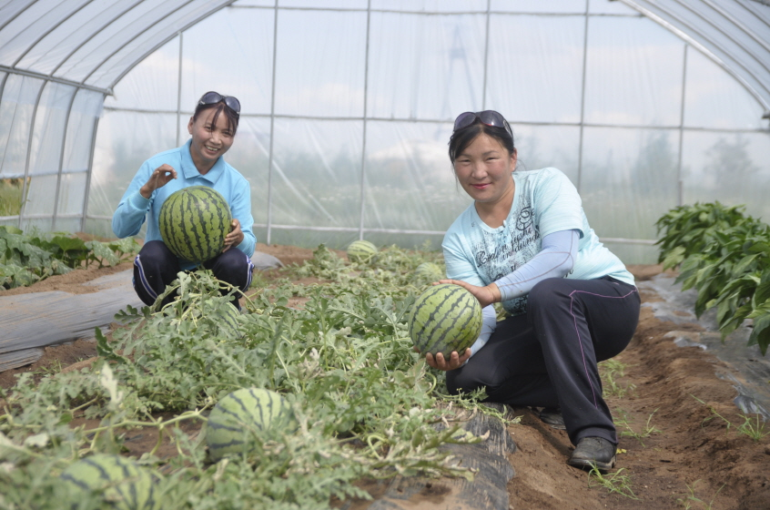
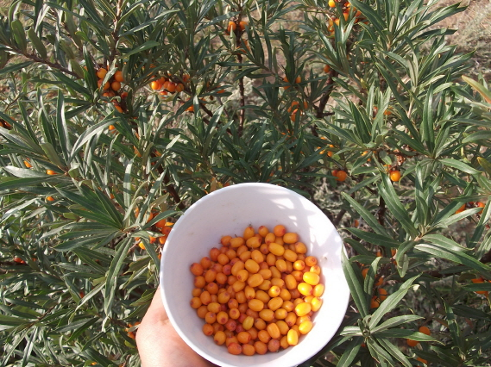
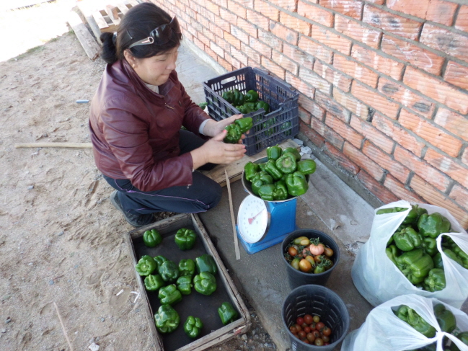
<Cultivation>
• Fruit Trees – Chachargan, Uhriin Nud, Apricot, etc.
• Cash Crops in Forestry Sites
– Green Peppers, Cabbage, Radish, Watermelon, etc.
Local Economic Self-Sufficiency
Participation

Slide 27
Local Economic Self-Sufficiency
Indicator |  | Explanation of figure, such as time period measured
Agricultural yields before and after | 5,200 kg (including 1,700 kg of fruit) and 30,000 seedlings | Sales revenue for this was $96,800 ▶3,500 kg of crops for self-consumption include potatoes, cabbages, carrots, pumpkins, radish, tomatoes, cucumbers ▶1,700 kg of crops for sale include sea buckthorn trees, and black currant trees (1 kg = $4 USD with a total of $6,800) ▶30,000 trees (at $3 USD per tree equals $90,000 USD)
Local people’s income | $96,800 USD | $96,800 = 70 households x $1,383 USD annually from sales revenue (see above box) For one household, Mongolian minimum wage is $1,381 USD annually

Slide 28
Local Sustainability of The Local
Participation
Empowerment
Ownership
• Local Economic
Self-Sufficiency
• Economic
Empowerment
Social Empowerment

Slide 29
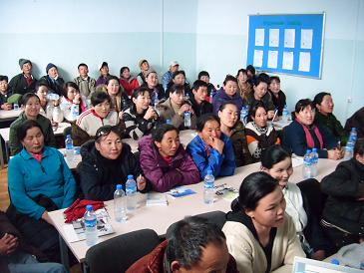
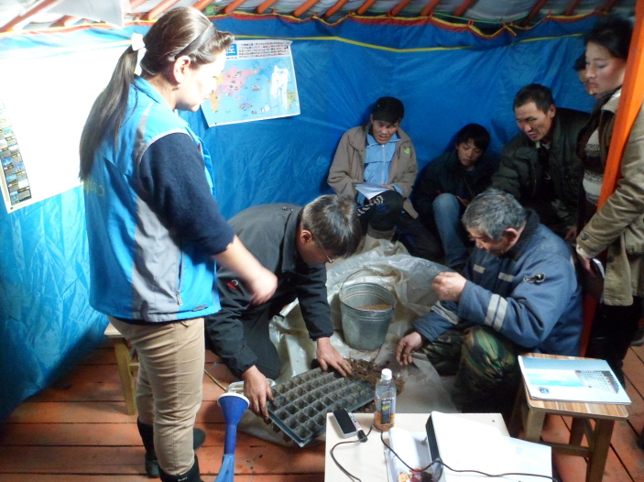
<Vocational Education>
• Offering Agroforestry Manager Qualification Course for Local
- Theoretical Education
- Agro-forestry Techniques
Economic Empowerment
Empowerment
which can be easily achieved

Slide 30
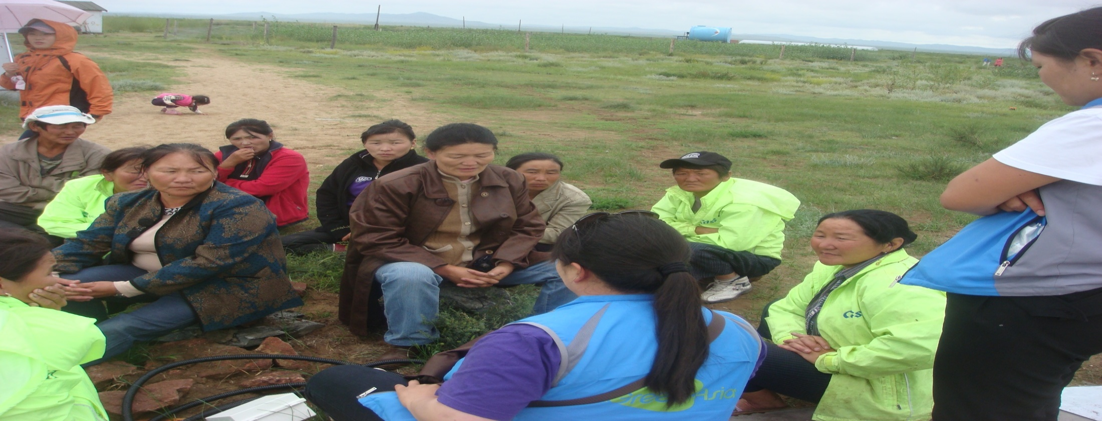
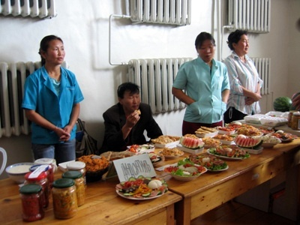
교육
Social Empowerment
Empowerment
<Organizing The Local>
• Monthly Local Meeting
• Team Leader System
• Organization of Local Events
Notes:
.

Slide 31
Local Sustainability of The Local
Participation
Empowerment
Ownership
• Local Economic
Self-Sufficiency
• Economic
Empowerment
Social Empowerment
• Creating
a Sustainable Form
of the Project

Slide 32
Trainee
• Contract by the year
• After 3years of Training, become a co-op member
Creating a Sustainable Form of the Project
Ownership
The Local
Co-op
• Joint Ownership of Forest
• Joint Management of
Community Fund
• Establishment of
Fruit processing Factory
: Develop into
Social Enterprise
Co-op Member
• Managing 300 Chachargans
and 1000-1500 Windbreaks
• Having Ownership of Harvest
• Paying 50% of Sales to Co-op
- 30% for Community Fund
- 20% for Forestry Maintenance

Slide 33
Local Sustainability of The Local
Participation
Empowerment
Ownership
• Economic
Empowerment
• Creating
a Sustainable Form
of the Project
• Local Economic
Self-Sufficiency
• Social Empowerment

Slide 34
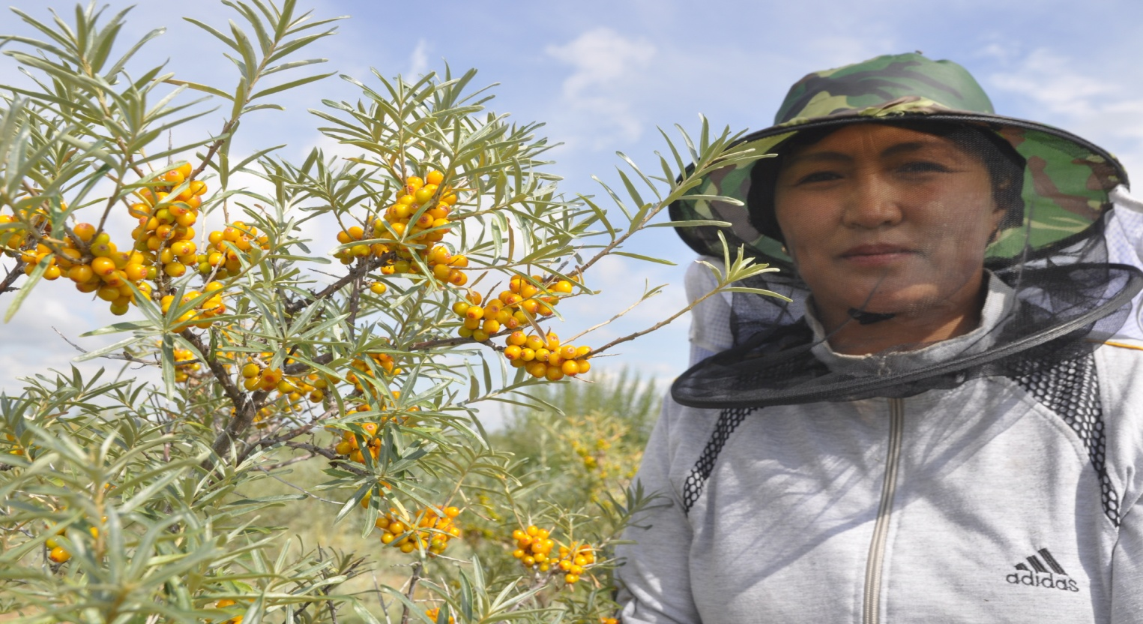
“We are indeed lucky to do good things visible and tangible”
“I hope more people to know this work is beneficial to our children and being productive for this region, and to cooperate with us”.
The Story of Sarangchimeg

Slide 35
Local Sustainability
The Region
The Local
Participation
Empowerment
Ownership

Slide 36
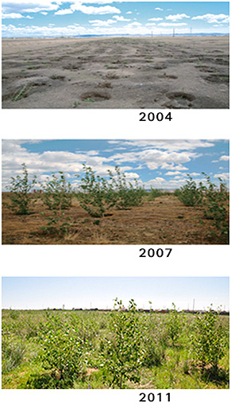
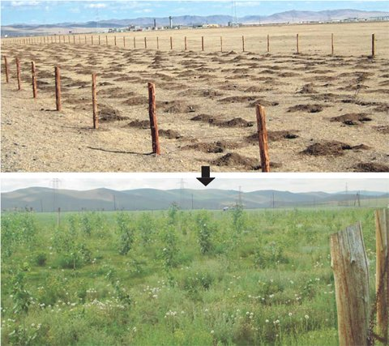
Environmental Impact 환경적 효과
Increase in grassland production
(초지 생산량 증대)
Land fertility improvement
(토지 비옥도 증대)

Slide 37
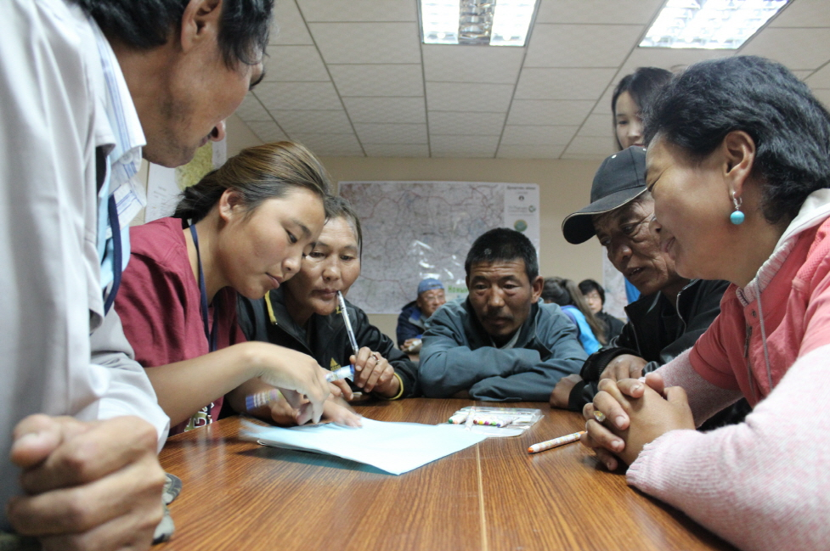
Social Impact 사회적 효과
Empowerment of the Locals by participating (지역 주민 참여 및 역량 강화)
Arrange monthly meeting (월례회의 진행):
Discuss current activities and future endeavours and events
Host a local market to sell their fruit harvest
(생산자-소비자간 직접적 수확물 판매)
Notes:
Green Asia Network's work is implemented through consultation with the local people, approximately 600 of whom are eco refugees. Green Asia Network is committed to ensuring that people affected by land degradation have the capabilities and experience to sustain themselves while also nurturing the environment. This is done together with people by encouraging active participation. Each month, the local participants and a Green Asia Network project leader gather to discuss current activities and future endeavours and events. In many of the sites, the local people have been brought together from different areas to work on a project; thus, these meetings serve the dual purpose of empowering local people while fostering a sense of community among them. For example, one of the ideas that came from a meeting in Bayannuur led to the people coming together to host a local market to sell their fruit harvest and clothes to pay for children’s books.

Slide 38
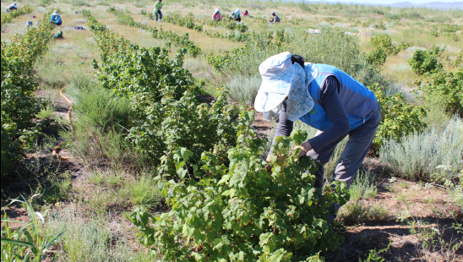
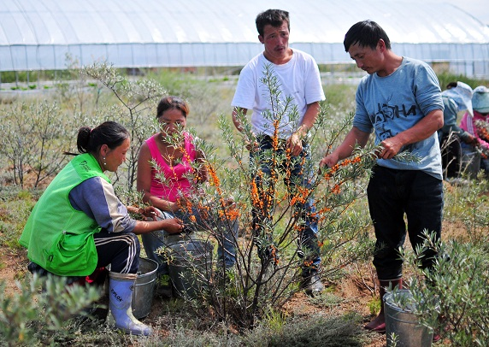
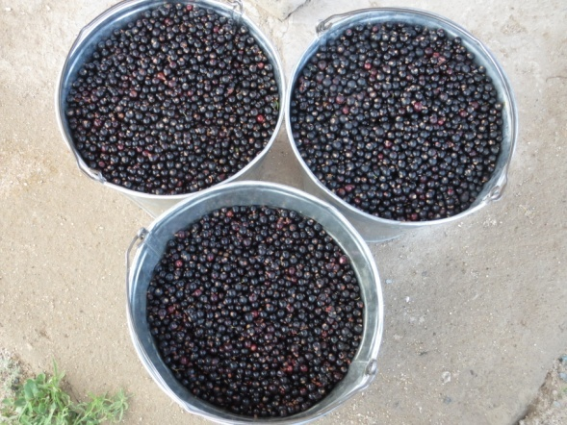
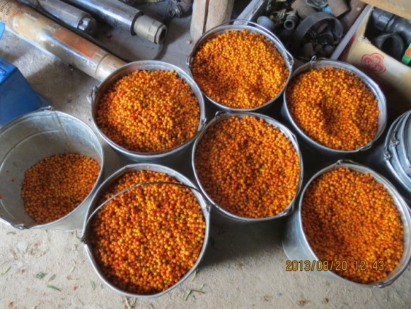
Economic Impact 경제적 효과
Improved economic opportunities (경제적 효과 증대)
Fruit tree cultivation: Sea buckthorn and black currant (유실수 재배)
Raising tree saplings and harvesting crops (양묘 및 농작물 생산)
All profit earned from these sales will be retained by the locals
(수확물 판매를 통해 얻어진 소득은 지역민들에게 돌아갑니다)
Black currant
(우흐린누드)
Sea buckthorn
(차차르간)
Notes:
Improved economic opportunities:
Based on Green Asia Network’s experience, it takes approximately five years of afforestation work to restore the land. Local participants earn income through planting seedlings and raising saplings, which are eventually sold to Green Asia Network for $3 USD per tree. For instance, in Bayannuur and Erdene districts, approximately 20,000 – 30,000 trees a year are sold, generating $60,000 to $90,000 for the thirty-five participants in that area.
They also work in agriculture, such as fruit tree cultivation or other crops. Sea buckthorn and black currant sell for $3 USD and $5 USD per kilogram respectively. However, Green Asia Network continues to work with locals to develop business opportunities that enable them to sell directly to customers, allowing them to earn a higher profit. Considering the number of fruit trees already planted, this can generate a total of $500,000 USD ($400,000 from Sea buckthorn and $100,000 from black currant). All profit earned from these sales will be retained by the local participants, who will decide as a collective on how to invest the money.

Slide 39
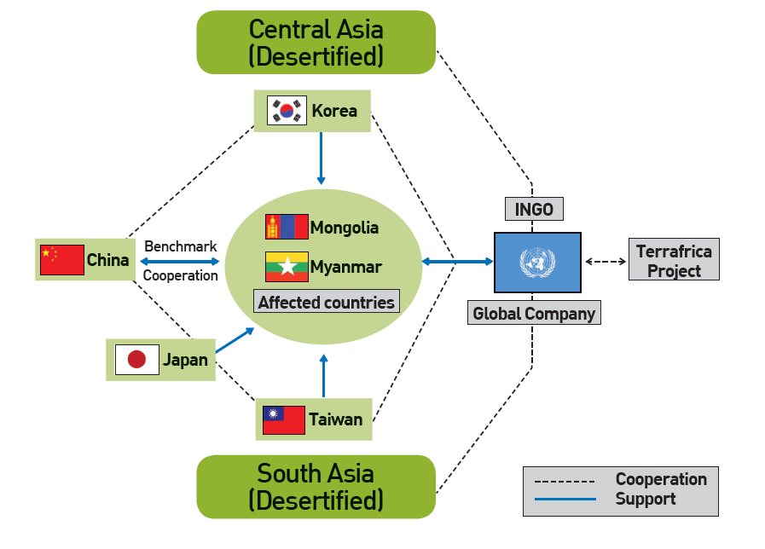
‘TerrAsia’ Project
Gan’s Model Spreading Strategy

Slide 40
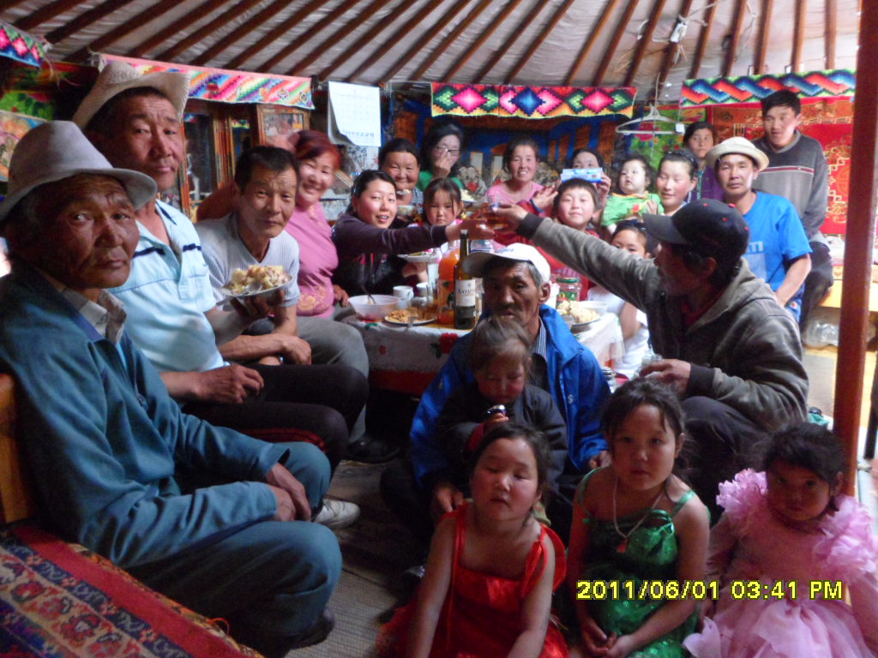
Design our common future!

